Slide 1
DataBase Term Project
- Simple Twitter Site
202135529 남윤주
202135552 오송정
202135568 이지해
202135570 이현지

Slide 2
Preview

Slide 3
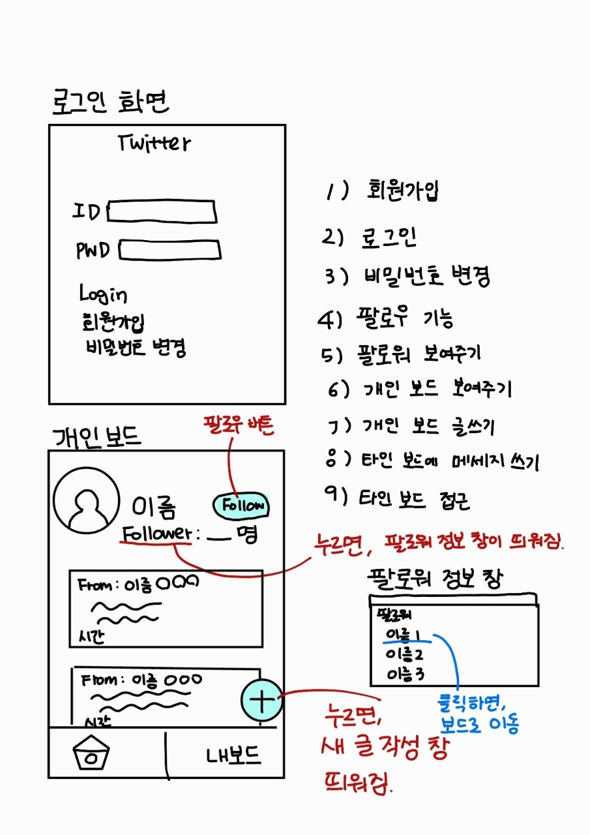
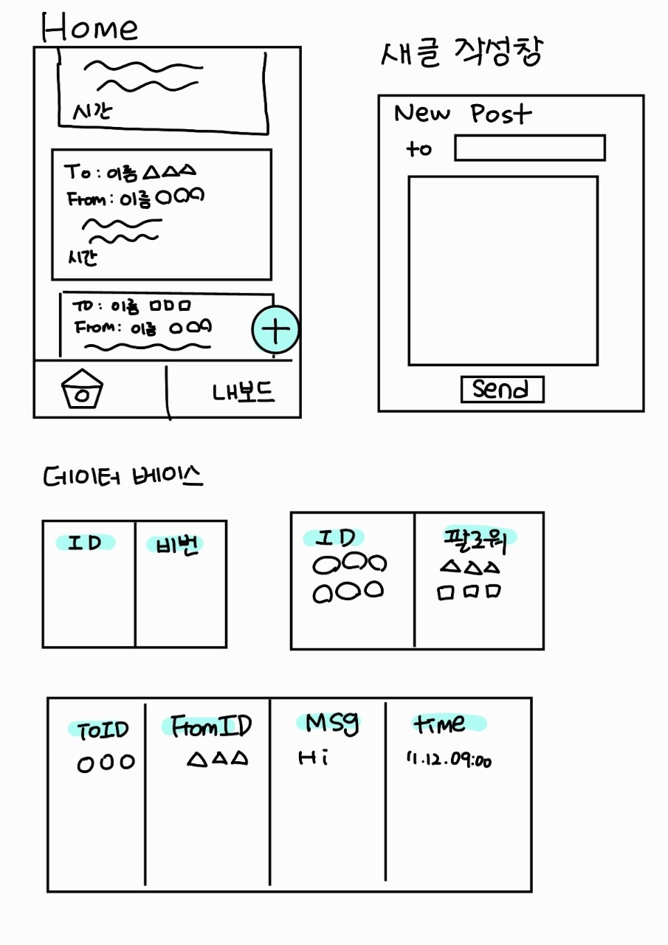
Design GUI&DB

Slide 4
DataBase

Slide 5
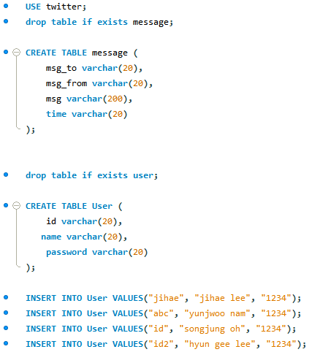
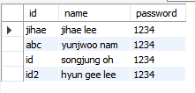
Database

Slide 6
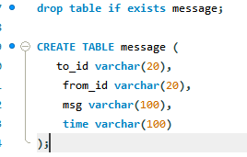
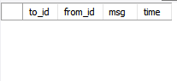
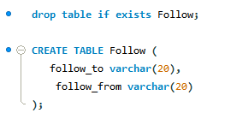
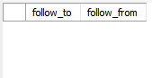
Database

Slide 7
Login

Slide 8
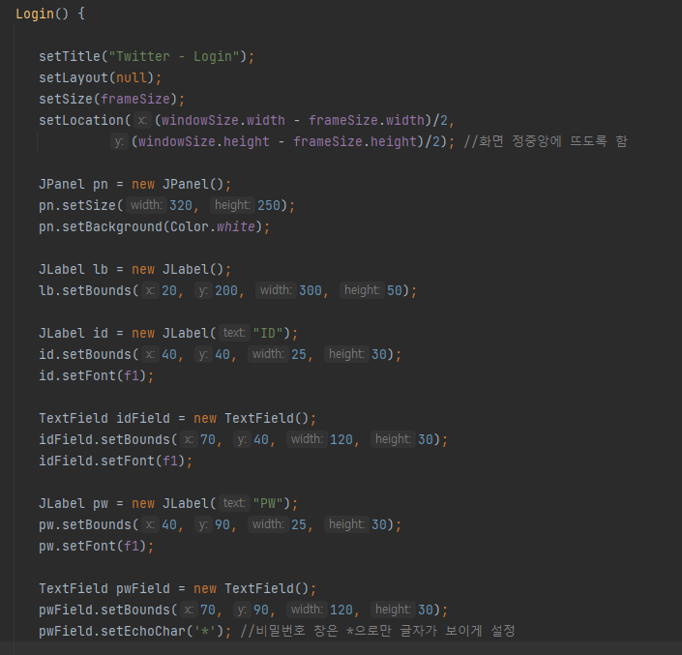
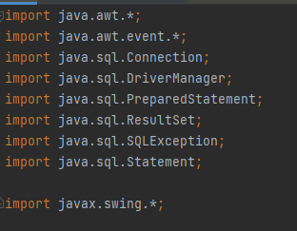
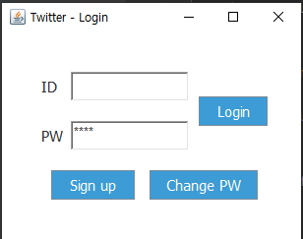
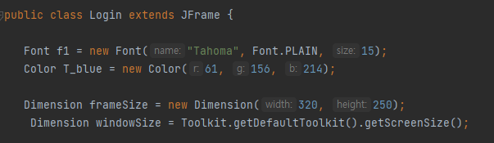


Login

Slide 9
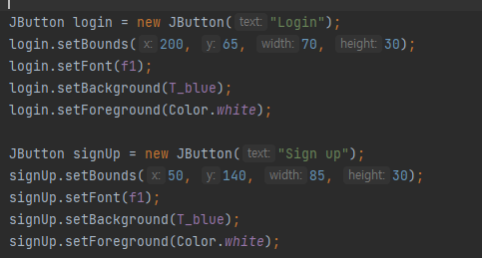
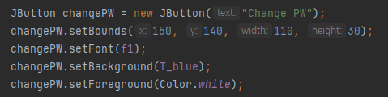
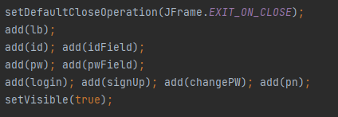
Login

Slide 10
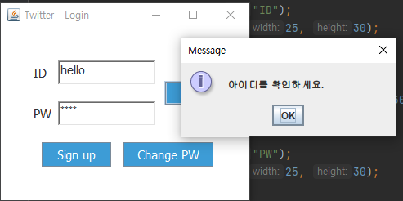
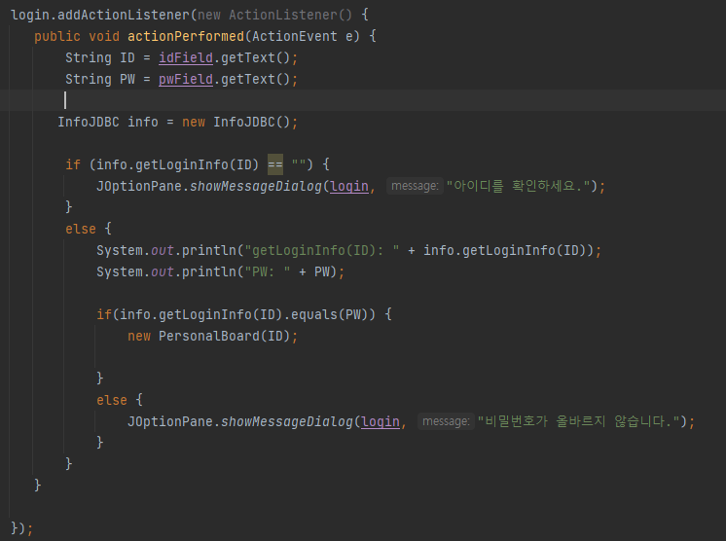
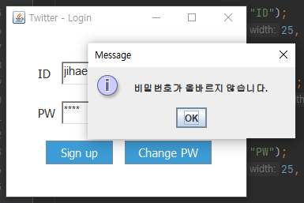
Login

Slide 11
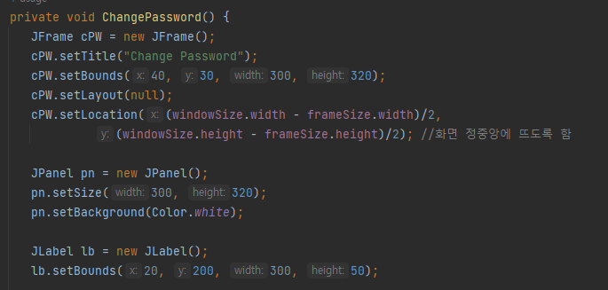
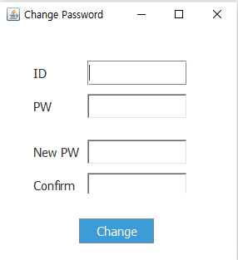
Change PW

Slide 12
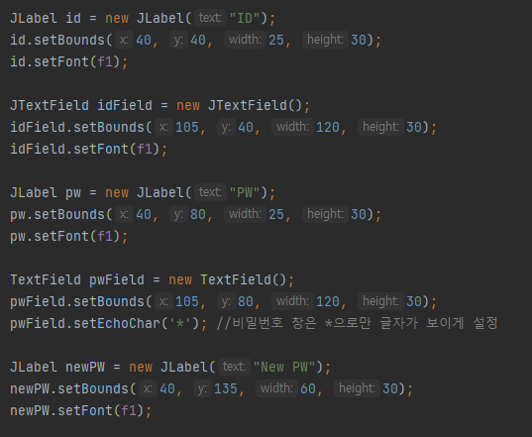
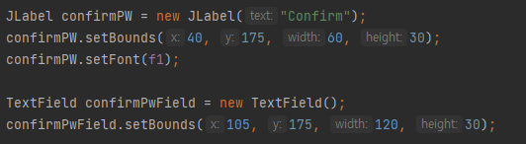
Change PW

Slide 13
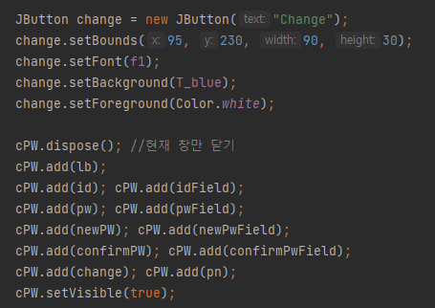
Change PW

Slide 14
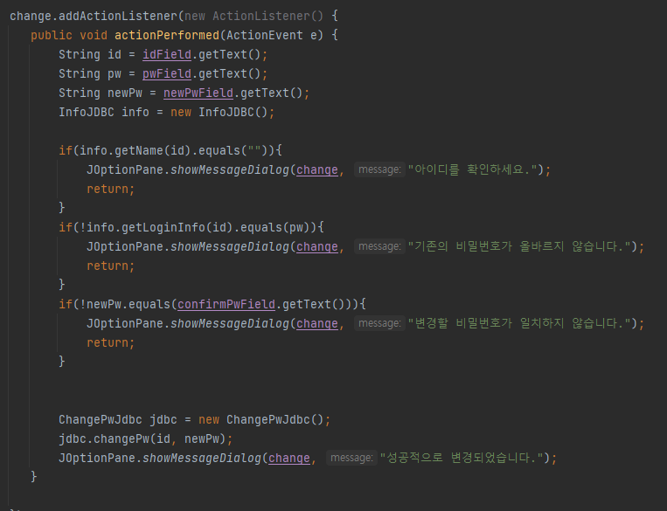
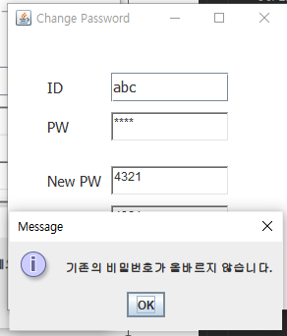
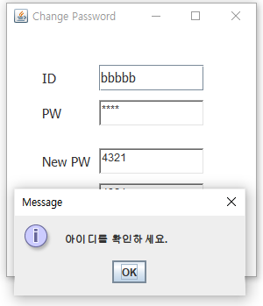
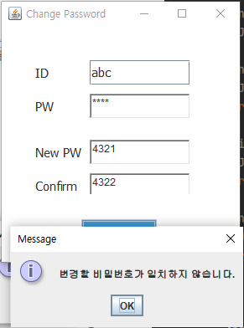
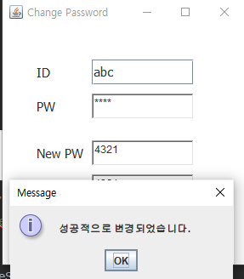
Change PW
1
2
1
2
3
3
4
4

Slide 15
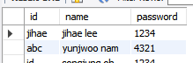

Change PW
class ChangePwJdbc{ Connection con; Statement stmt; ChangePwJdbc(){ String url = "jdbc:mysql://localhost:3306/twitter"; String userid = "twitter"; String pwd = "1234"; try { con = DriverManager.getConnection(url, userid, pwd); stmt = con.createStatement(); } catch (SQLException e) { e.printStackTrace(); } }
public void changePw(String id, String newPw) { String query = "UPDATE user SET password = \"" + newPw + "\" WHERE id = \"" + id +"\";"; try { Statement stmt=con.createStatement(); stmt.executeUpdate(query); } catch (SQLException e) { e.printStackTrace(); } }

Slide 16
Sign up

Slide 17
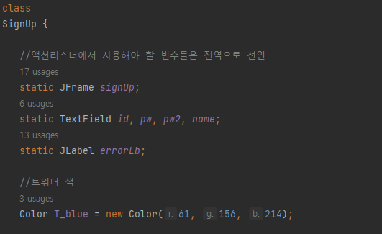
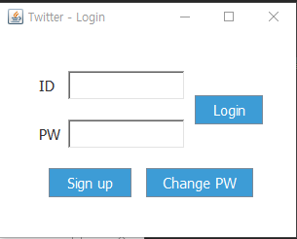
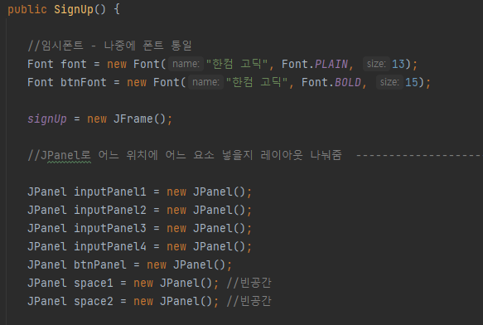
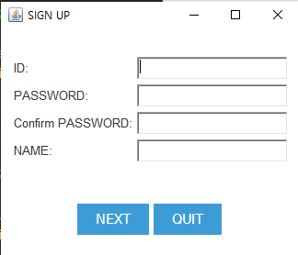
Sign up

Slide 18
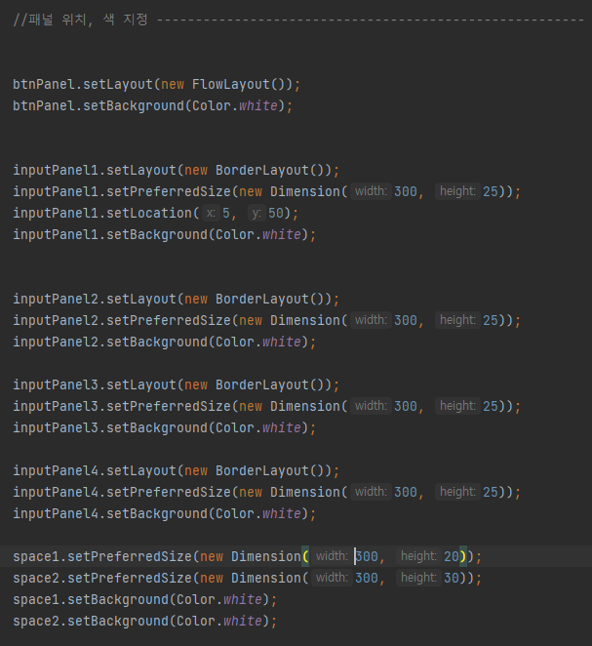
Sign up

Slide 19
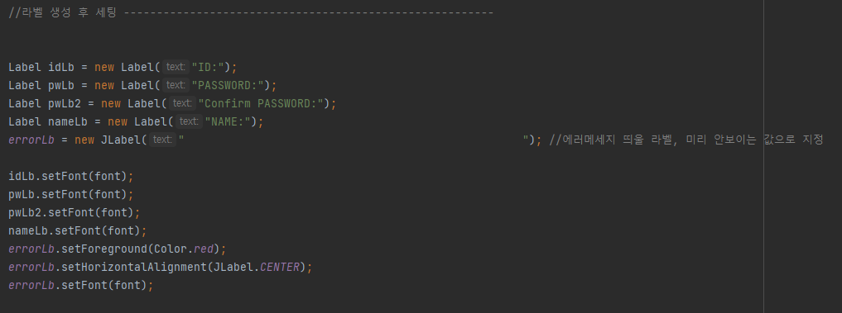
Sign up

Slide 20
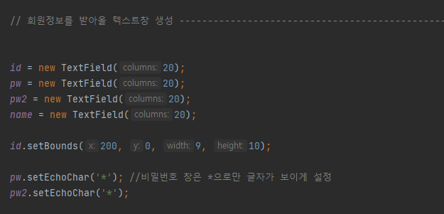
Sign up

Slide 21
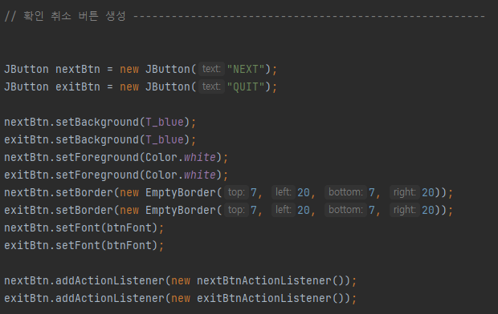
Sign up

Slide 22
Sign up
// JFrame에 차례대로 배치 ---------------------------------------------------- signUp.add(space1); signUp.add(inputPanel1); inputPanel1.add(idLb); inputPanel1.add(id, BorderLayout.EAST); signUp.add(inputPanel2); inputPanel2.add(pwLb); inputPanel2.add(pw, BorderLayout.EAST); signUp.add(inputPanel3); inputPanel3.add(pwLb2); inputPanel3.add(pw2, BorderLayout.EAST); signUp.add(inputPanel4); inputPanel4.add(nameLb); inputPanel4.add(name, BorderLayout.EAST); signUp.add(space2, BorderLayout.CENTER); space2.add(errorLb); signUp.add(btnPanel); btnPanel.add(nextBtn); btnPanel.add(exitBtn); // 창 설정 ----------------------------------------------------------------- Dimension frameSize = new Dimension(340, 285); Dimension windowSize = Toolkit.getDefaultToolkit().getScreenSize(); signUp.setTitle("SIGN UP"); signUp.setDefaultCloseOperation(JFrame.EXIT_ON_CLOSE); signUp.setLayout(new FlowLayout()); signUp.setBackground(new Color(61, 156, 214)); signUp.setSize(frameSize); signUp.setVisible(true); signUp.getContentPane().setBackground(Color.white); signUp.setLocation((windowSize.width - frameSize.width)/2, (windowSize.height - frameSize.height)/2); //화면 정중앙에 뜨도록 함

Slide 23
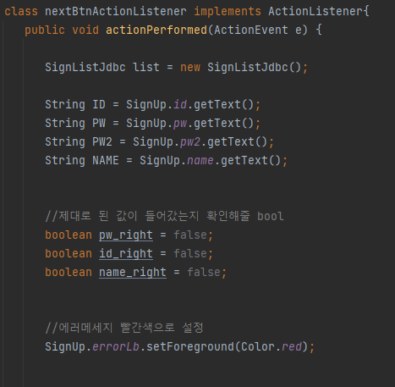
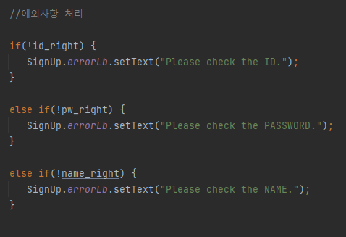
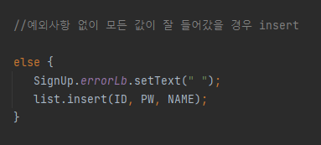
Sign up

Slide 24
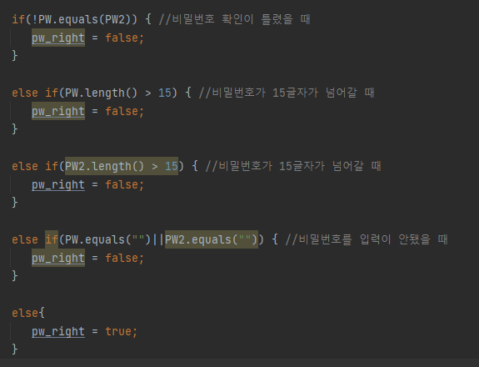
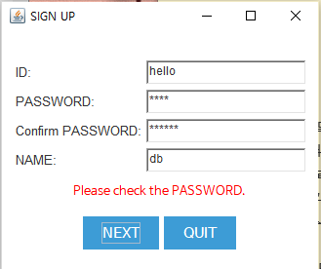
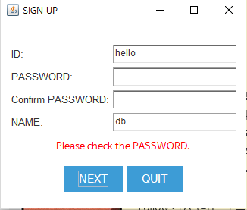
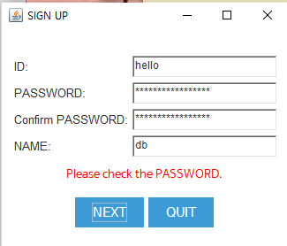
Sign up
1
1
2
3
2
2
3

Slide 25
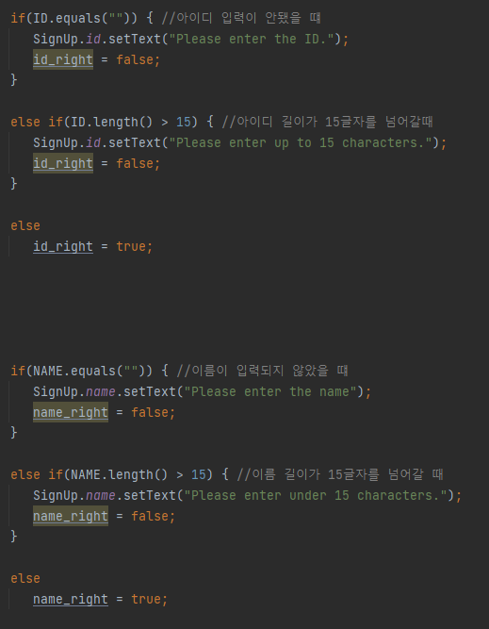
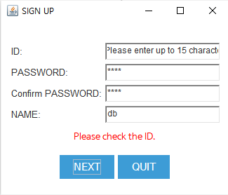
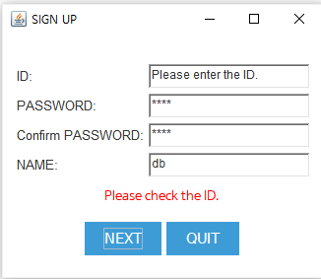
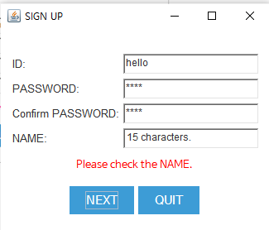
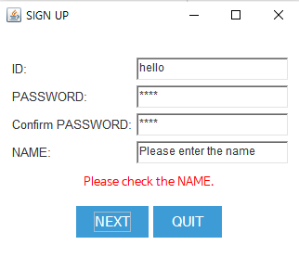
Sign up
2
1
1
2
4
3
3
4

Slide 26
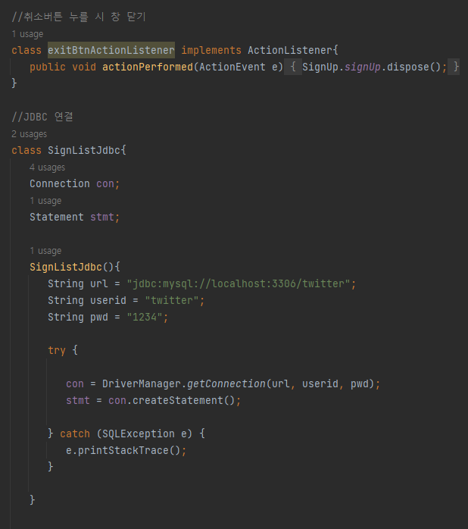
Sign up

Slide 27


Sign up

Slide 28


JDBC connection

Slide 29



JDBC connection

Slide 30
Personal Board

Slide 31

Pesonal Board
public class PersonalBoard extends JFrame { String login_; JPanel messagePn; int vertical, messageNum; Color T_blue = new Color(61, 156, 214); //Font Font font = new Font("한컴 고딕", Font.PLAIN, 15); Font f1 = new Font("한컴 고딕", Font.BOLD, 40); Font f2 = new Font("SanSerif", Font.PLAIN, 20); Font f3 = new Font("한컴 고딕", Font.PLAIN,25); Font f4 = new Font("한컴 고딕", Font.BOLD,30); Font f5 = new Font("한컴 고딕",Font.BOLD,17); //titile Font f6 = new Font("한컴 고딕",Font.PLAIN,13); //text area Font f7 = new Font("한컴 고딕", Font.ITALIC, 17); String userName; String userId;

Slide 32

Pesonal Board

Slide 33

Pesonal Board
1
1
2
3
2
3

Slide 34

Pesonal Board

Slide 35

Message Panel

Slide 36



Search

Slide 37

Search

Slide 38


Search

Slide 39

Following & Followers
//팔로워 버튼 JButton bt1 = new JButton("Follower"); bt1.setBounds(300,210,130,30); bt1.setBorder(new EmptyBorder(0, 0, 0, 0)); bt1.setBackground(T_blue); bt1.setForeground(Color.white); bt1.setFont(f2); bt1.setFocusPainted(false); bt1.addActionListener(new MyActionListener()); //누르면 새 창 add(bt1); //팔로잉 버튼 JButton bt2 = new JButton("Following"); bt2.setBounds(460,210,130,30); bt2.setBorder(new EmptyBorder(0, 0, 0, 0)); bt2.setBackground(T_blue); bt2.setForeground(Color.white); bt2.setFont(f2); bt2.setFocusPainted(false); bt2.addActionListener(new MyActionListener2()); //누르면 새 창 add(bt2);

Slide 40


Following & Followers

Slide 41

Following & Followers

Slide 42


Following & Followers

Slide 43

Following & Followers

Slide 44


Unfollow

Slide 45


Unfollow

Slide 46
New Post

Slide 47
New Post
//NewPost 열기 button JButton bt4 = new JButton("New post"); bt4.setBounds(560,260,150,30); bt4.setBorder(new EmptyBorder(0, 0, 0, 0)); bt4.setBackground(T_blue); bt4.setForeground(Color.white); bt4.setFont(f2); bt4.setFocusPainted(false); bt4.addActionListener(new MyActionListener3()); add(bt4);
/** * New post 열기 새창 */ class MyActionListener3 implements ActionListener { public void actionPerformed(ActionEvent e) { new NewPost(userId); } }

Slide 48

New Post
public class NewPost extends JFrame { // Font Font f1 = new Font("나눔고딕",Font.BOLD,17); Font f2 = new Font("나눔고딕",Font.PLAIN,13); Font f3 = new Font("나눔고딕", Font.ITALIC, 17);
// New Post 창 NewPost(String userId){ // title JLabel lb1 = new JLabel("NEW POST"); lb1.setBounds(50,35,100,30); lb1.setFont(f1); // 이미지(뱅기뱅기) JLabel imgLabel = new JLabel(); ImageIcon icon = new ImageIcon("send.png"); Image img = icon.getImage(); Image updateImg = img.getScaledInstance(30,30,Image.SCALE_SMOOTH); ImageIcon updateIcon = new ImageIcon(updateImg); imgLabel.setIcon(updateIcon); imgLabel.setBounds(12,35,30,30); getContentPane().add(imgLabel);

Slide 49
New Post
// 입력창 JTextArea jt1 = new JTextArea(1,1); jt1.setBounds(50, 75, 460, 500); jt1.setFont(f2); // complete & time JLabel lb2 = new JLabel(); lb2.setBounds(50,600,300,30); lb2.setFont(f1); // Send button JButton bt1 = new JButton("Send"); bt1.setBounds(400, 600, 100, 30); bt1.setFont(f1);

Slide 50



New Post

Slide 51


New Post

Slide 52


New Post

Slide 53

New Post

Slide 54
InfoJDBC

Slide 55


InfoJDBC- connection & user name

Slide 56

InfoJDBC – get Follower

Slide 57

InfoJDBC – get Following

Slide 58

InfoJDBC – get Message

Slide 59

InfoJDBC – convert name to ID

Slide 60

InfoJDBC – get LoginInfo

Slide 61

InfoJDBC – following check

Slide 62

InfoJDBC – delete follow(unfollow)

Slide 63

InfoJDBC – set follow(following)

Slide 64
Demo

Slide 65
Demo Link
Login – Signup – change pw
https://youtu.be/L5nBtLm1iKk
Personal Board – following’s Board – New Post – Following & Follwers
https://youtu.be/CHR3wTvTG-Y

Slide 66
THANK YOU

